Slide 1

TO DO APP
Developed in 2023
- Arnab Das

Slide 2
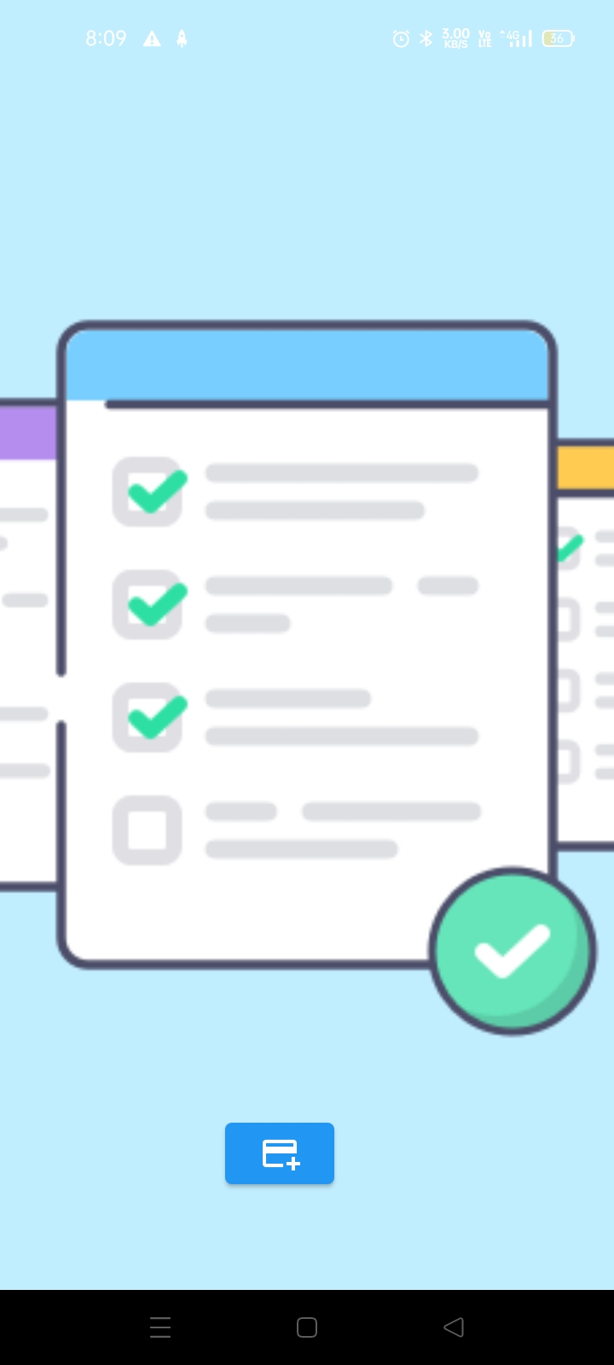
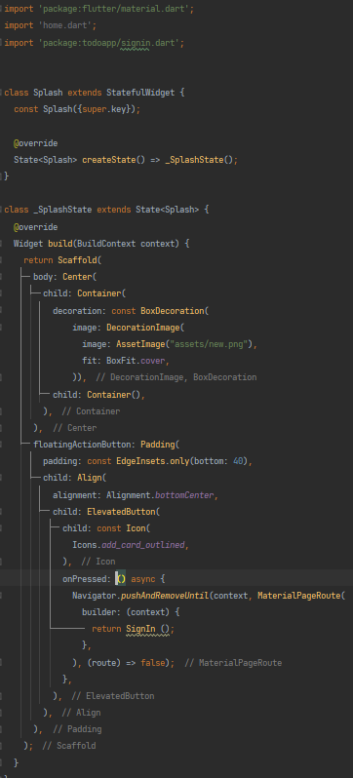
Splash Page
When you click this button, it will lead you to the login page.

Slide 3
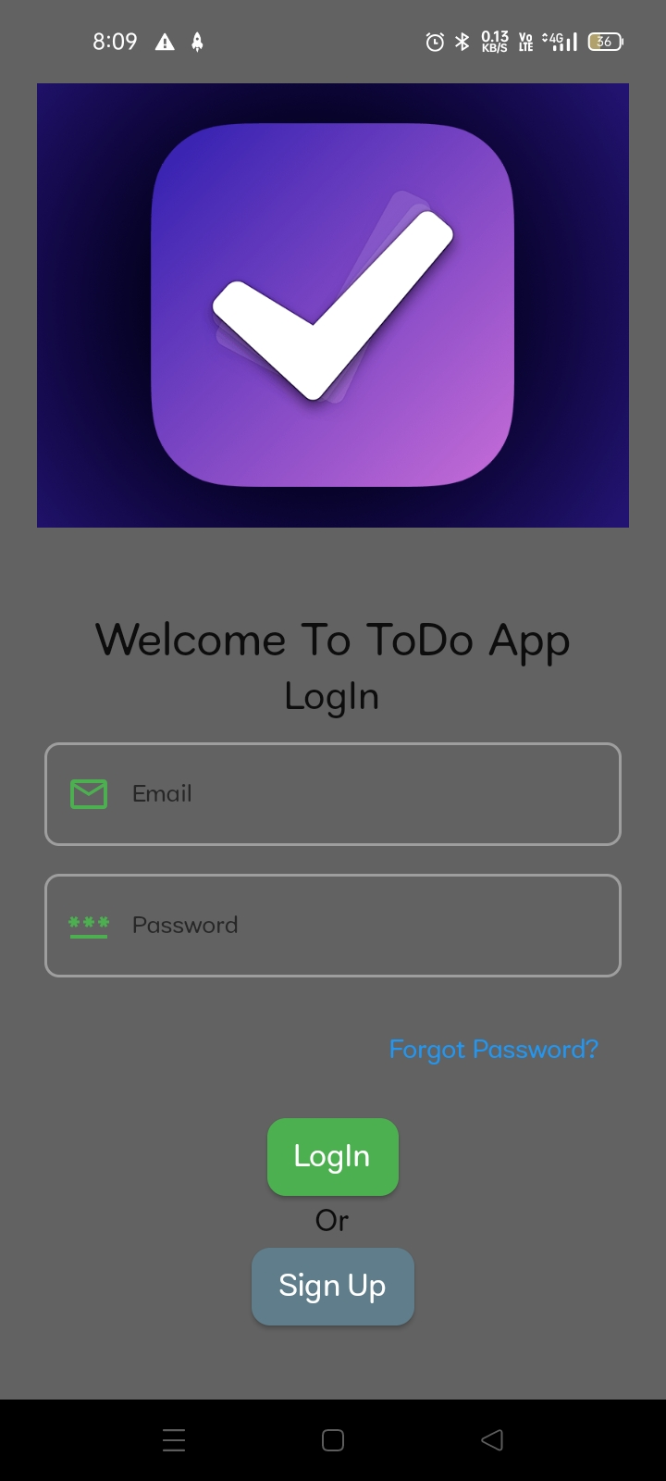
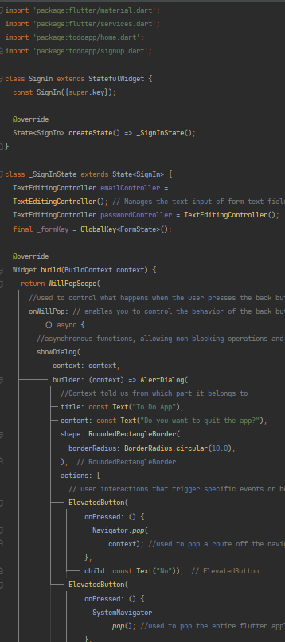
Login Page
provide your email address here
enter the password here
Upon clicking this button, you'll be directed to the app's main page.
After clicking this button, you will be taken to the signup page where you can register

Slide 4
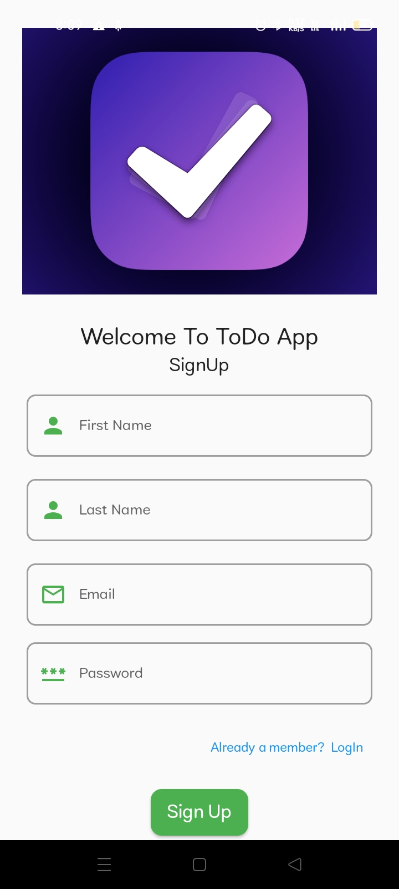
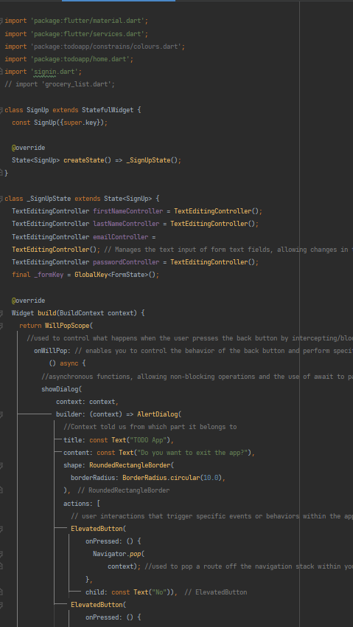
SignIn Page
provide your first name here
provide last name here
provide your email address here
create a pasword
Upon clicking this button, you'll be directed to the app's main page.

Slide 5
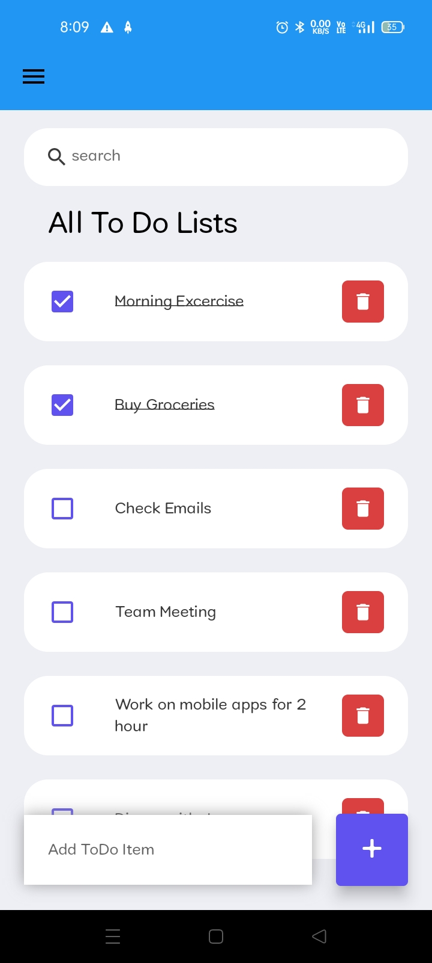
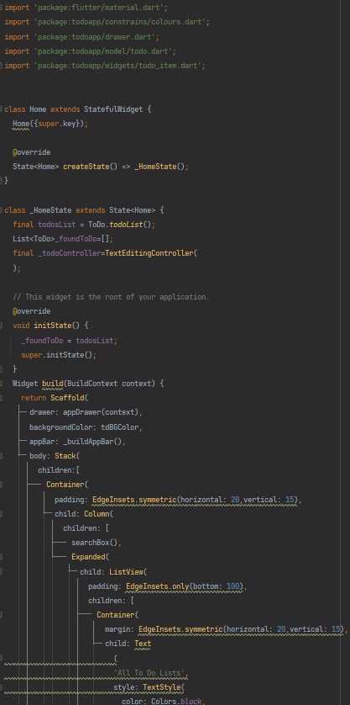
Side Menu
Search for existing tasks here
Remove the current task
Checkbox to indicate completion of tasks
Home Page
To create a task.

Slide 6
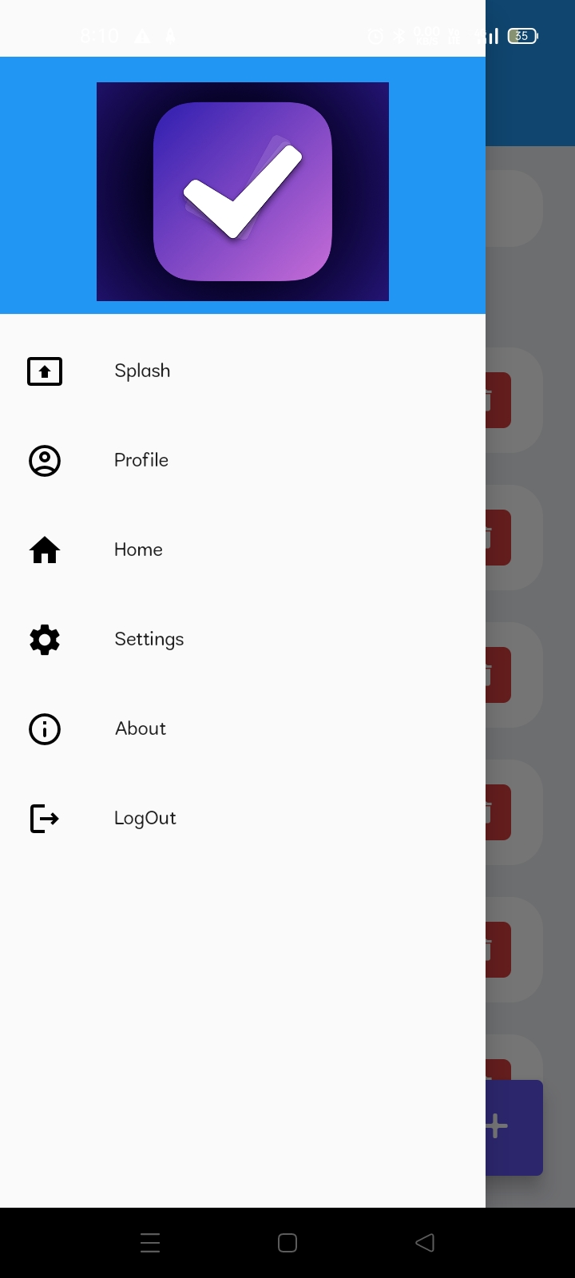
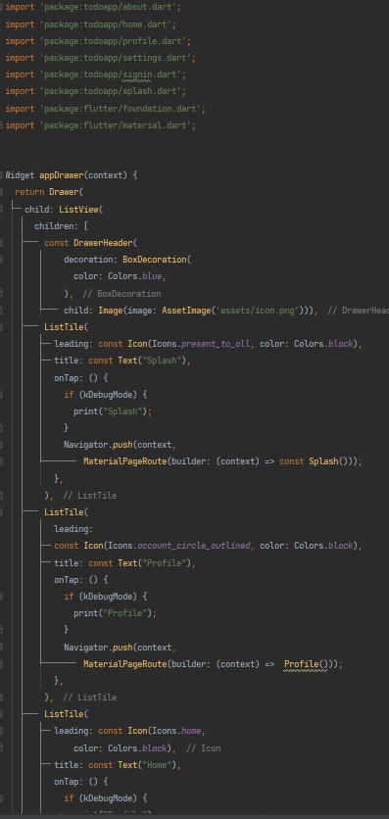
v
Drawer Page
It will navigate you to the Splash Page of this app.
It will navigate you to the Profile Page of this app.
It will navigate you to the Home page of this app again.
It will navigate you to the Settings Page of this app.
It will navigate you to the About Page of this app.
It will navigate you to the LogIn Page of this app.

Slide 7
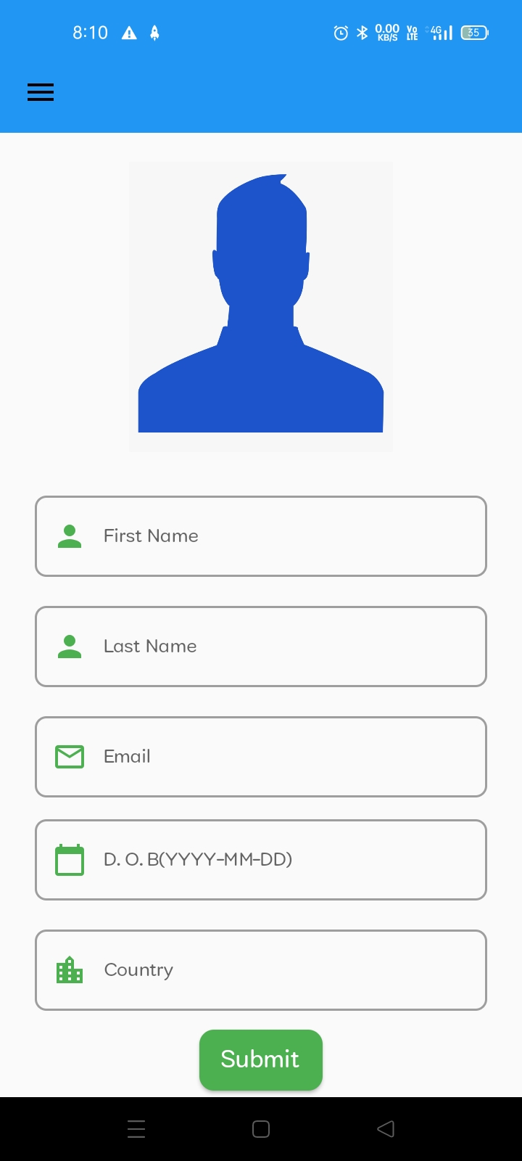
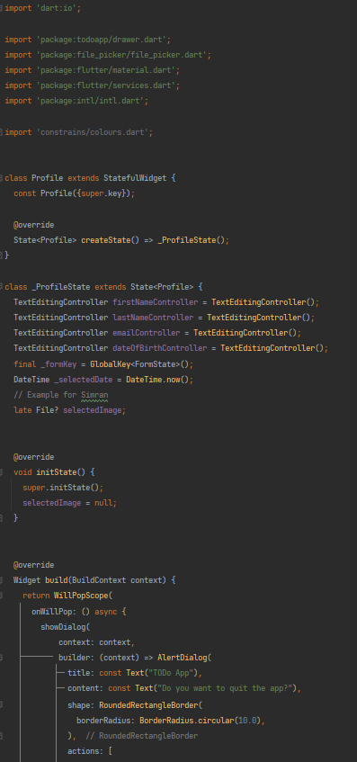
Profile Page
By clicking this, you can upload a profile picture from your gallery.
provide your first name here
provide last name here
provide your email address here
provide your date of birth.
enter your country

Slide 8
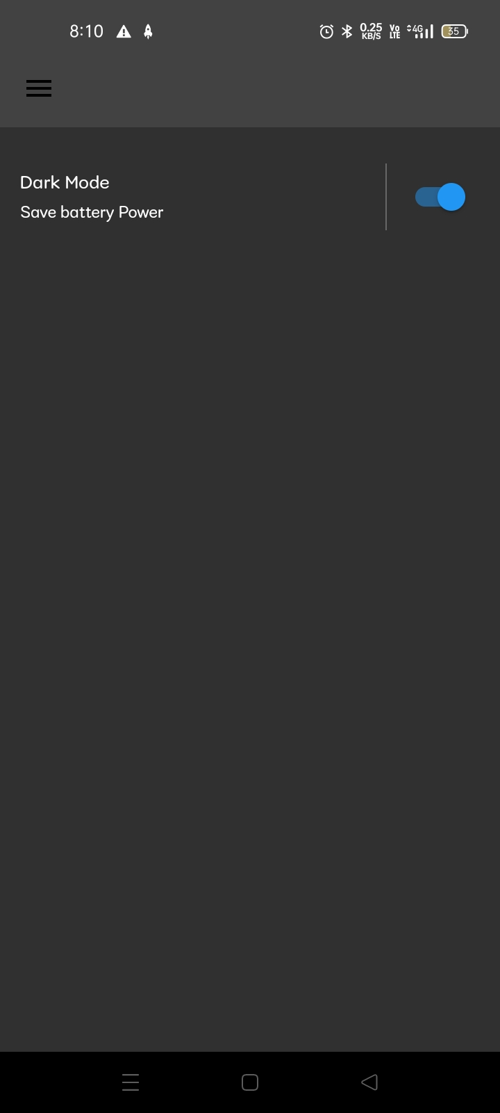
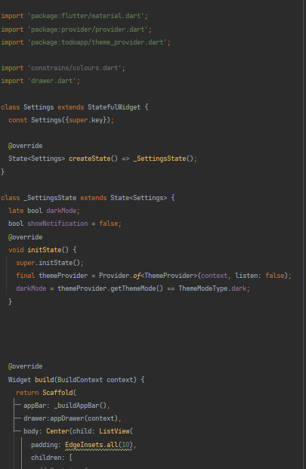
Enabling this will activate dark mode, while disabling it will enable light mode.
Settings Page

Slide 9
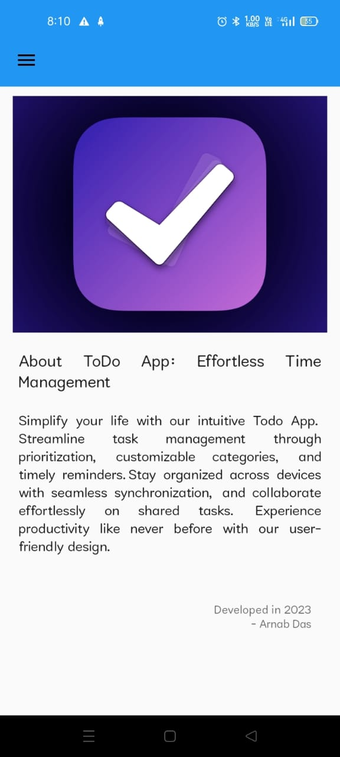
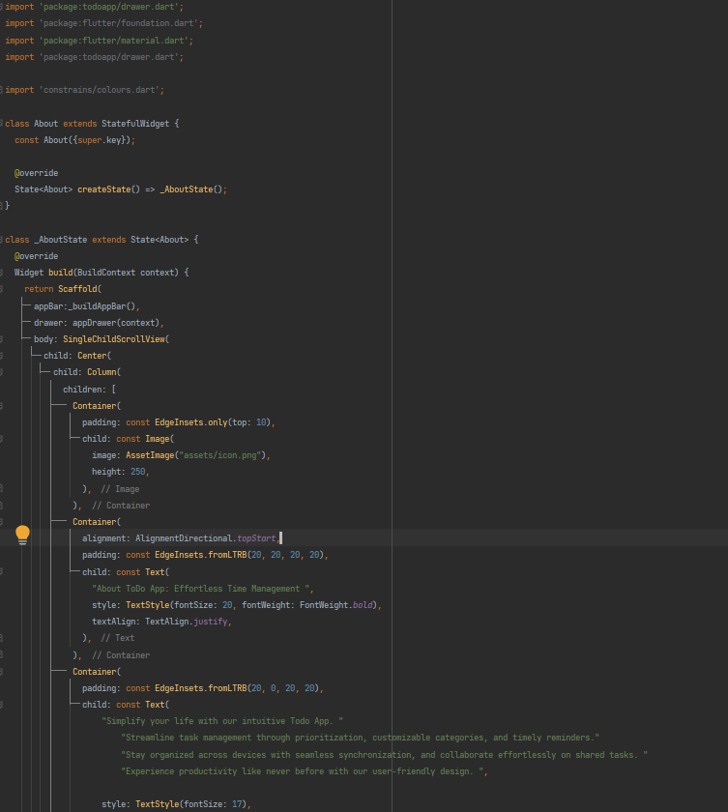
About Page

Slide 10
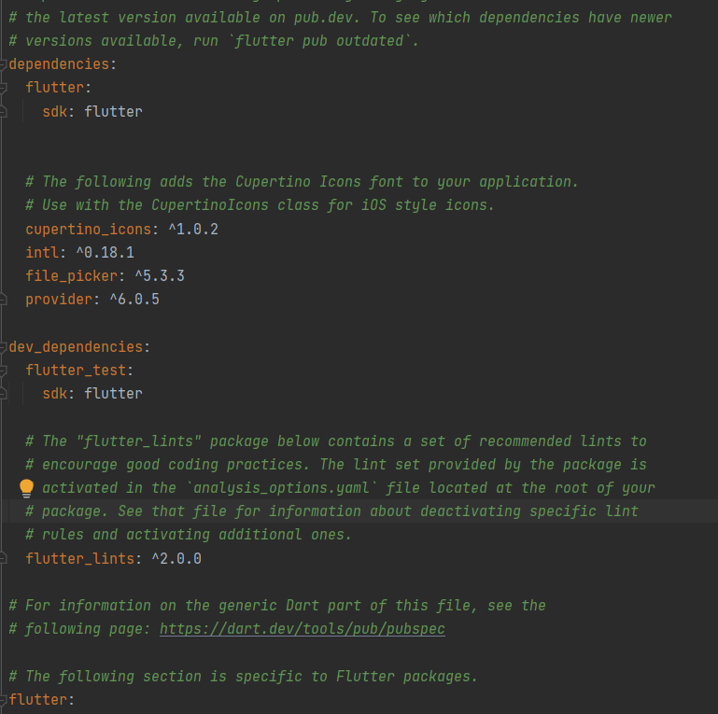
These are the dependencies added in the `pubspec.yaml` file.

Slide 11


